Slide 1
OfferUp onsite interview Prototype presentation
Presenter: Joe Ma
App name: Show College

Slide 2
Purpose
Fundamental Android concepts
Reactive / Asynchronous programming
Third party libraries
RxJava
Retrofit
Picasso
Gson
IcePick

Slide 3
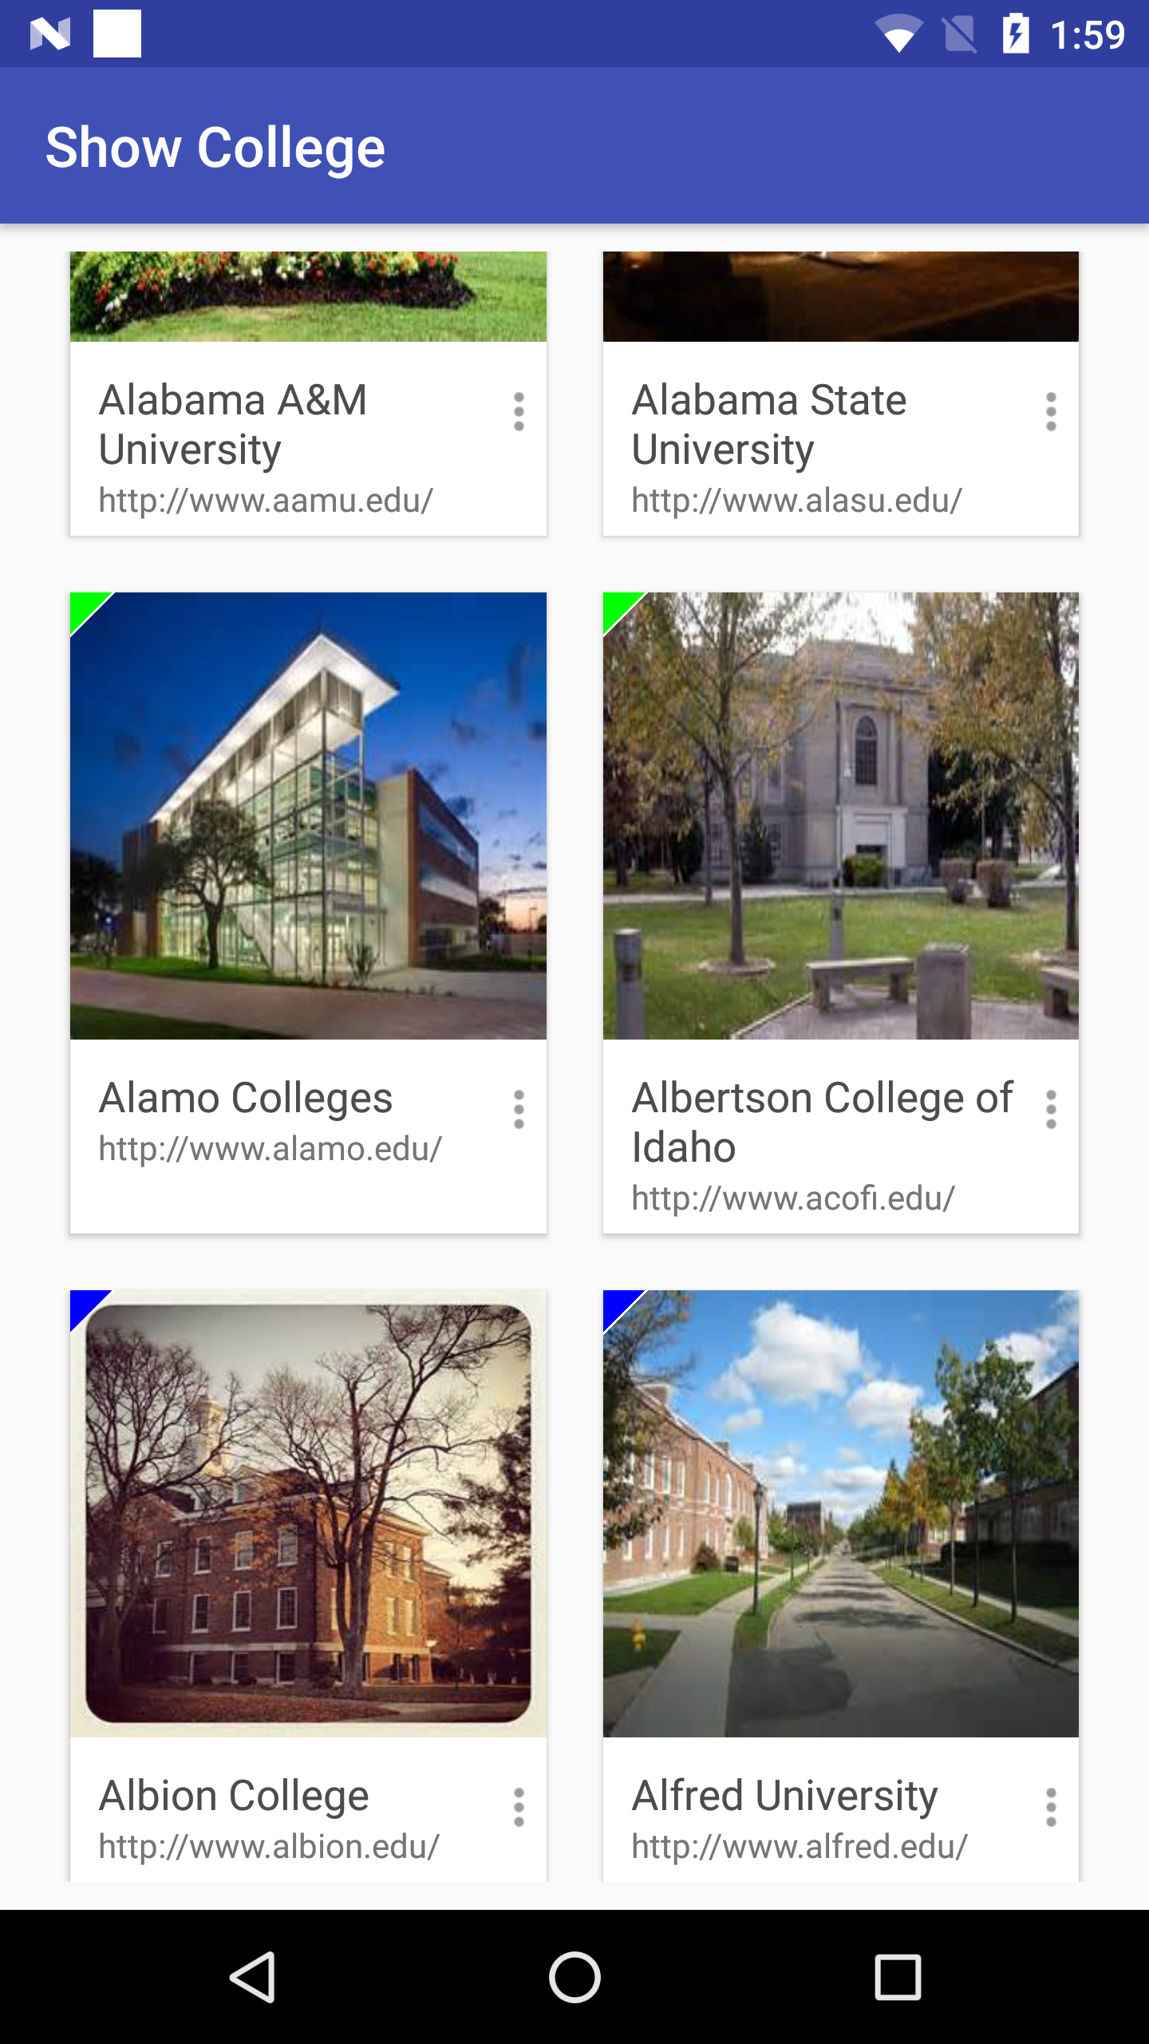
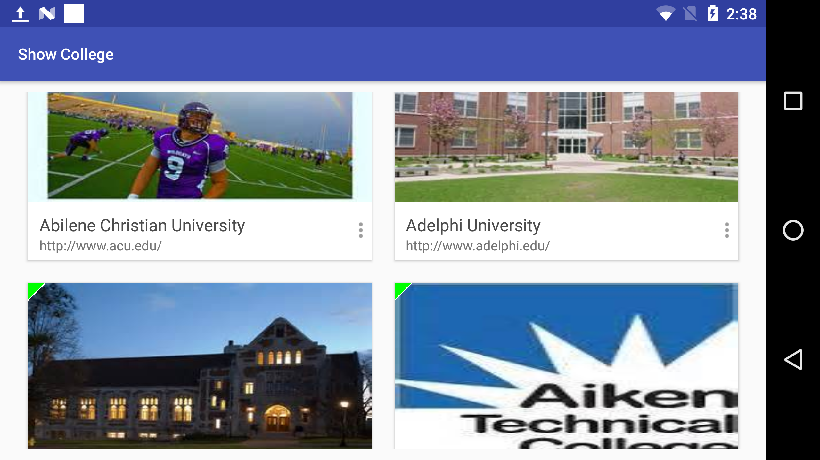

Slide 4
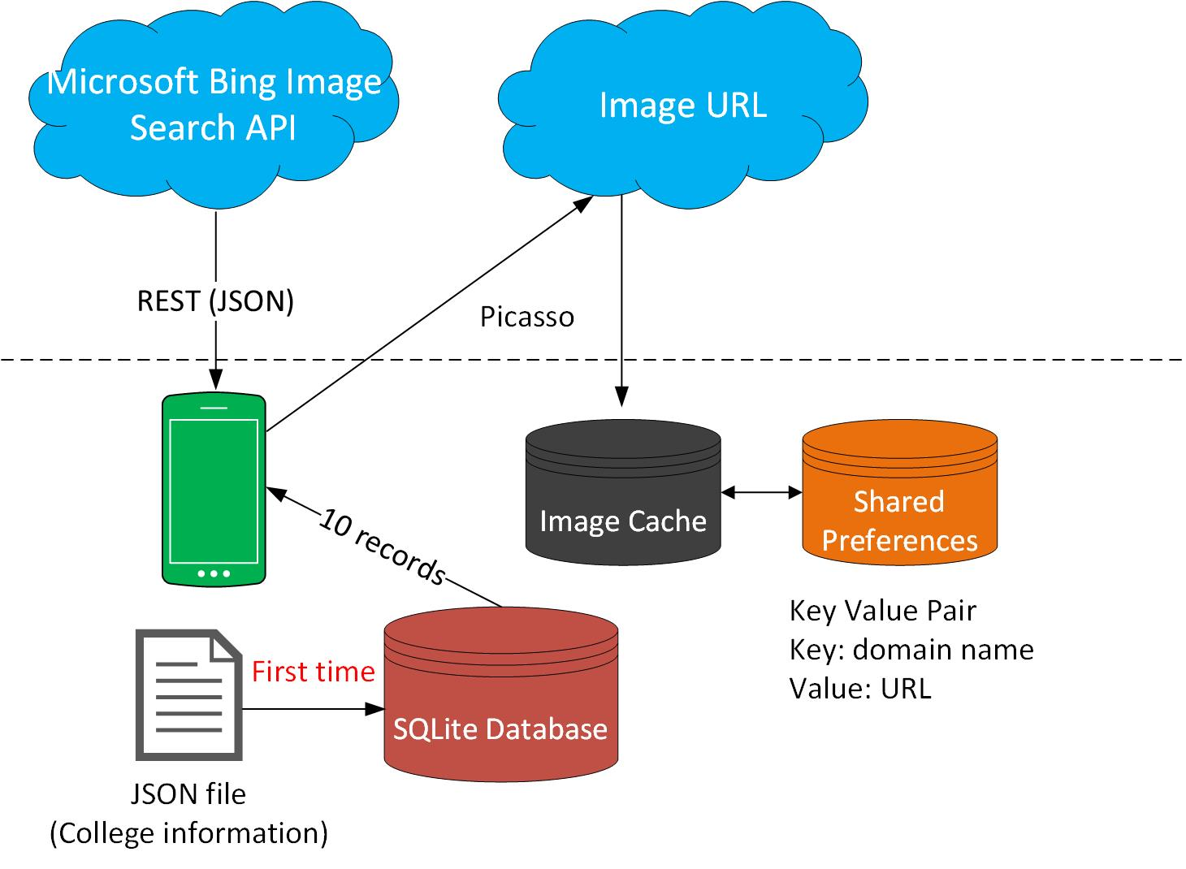

Slide 5
Fundamental Android concepts
Activity / Fragment (No MVP)

Slide 6
Fundamental Android concepts
Activity / Fragment (No MVP)
Rotation (Android Lifecycle)
IcePick
Parcelable

Slide 7
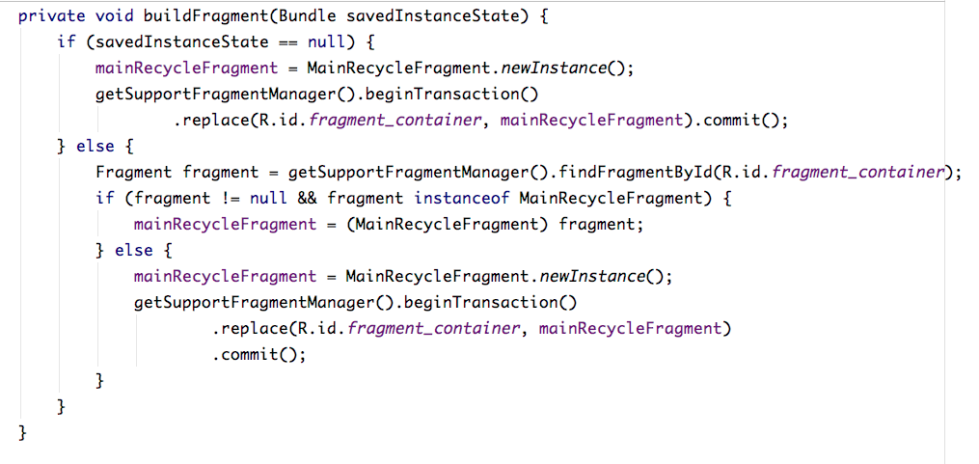
Rotation (Activity / Fragment)

Slide 8
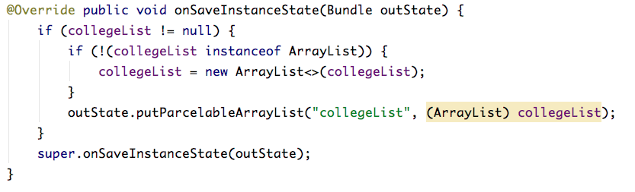
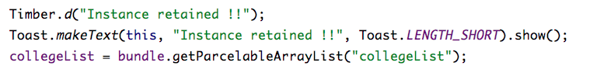
Rotation (Serialization)

Slide 9
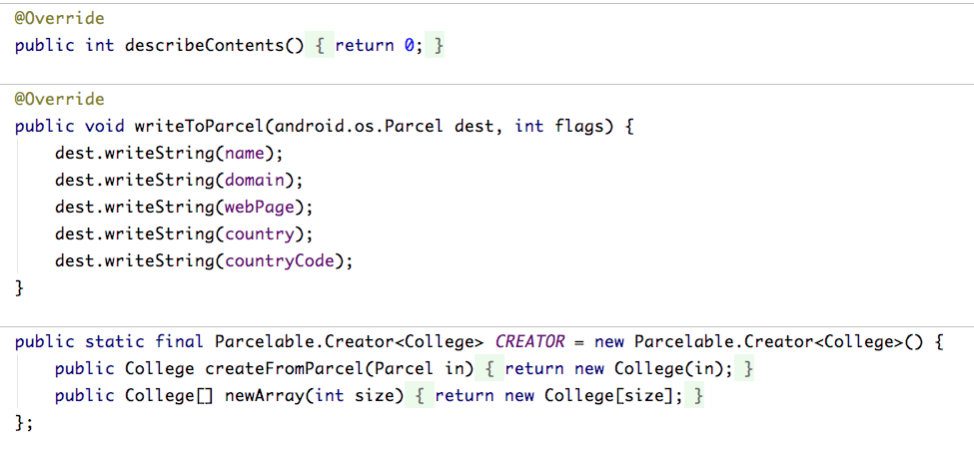
Rotation (Serialization)

Slide 10
Reactive / Asynchronous
RxJava (No AsyncTask)
Retrofit
Picasso (Image Caching lib)

Slide 11
Question and Answer

